Slide 1
Risk Management Life Cycle – 4-1-4
CASP+ - CAS-004

Slide 2
What is the Risk Management Lifecycle?
Risk Management Lifecycle
Identify
Assess
Control
Review
Risk Management.. Policies and processes used by an organization to locate, describe, prioritize, and mitigate risks in a consistent and repeatable way.
Identify—Recognize
Assess—Analyze Control—Reduce
Review—Re-evaluate

Slide 3
What are Risk Frameworks?
The basis of a risk management program
An authoritative reference
Select based on unique attributes and features (one size fits YOU !!!)
NIST Cybersecurity Framework (CSF)
NIST Risk Management Framework (RMF)
ISO 31000: 2018 - Risk Management Guidelines
Control Objectives for Information and Related Technologies (COBIT)
Committee of Sponsoring Organizations of the Treadway Commission, (COSO) Enterprise Risk Management — Integrated Framework

Slide 4
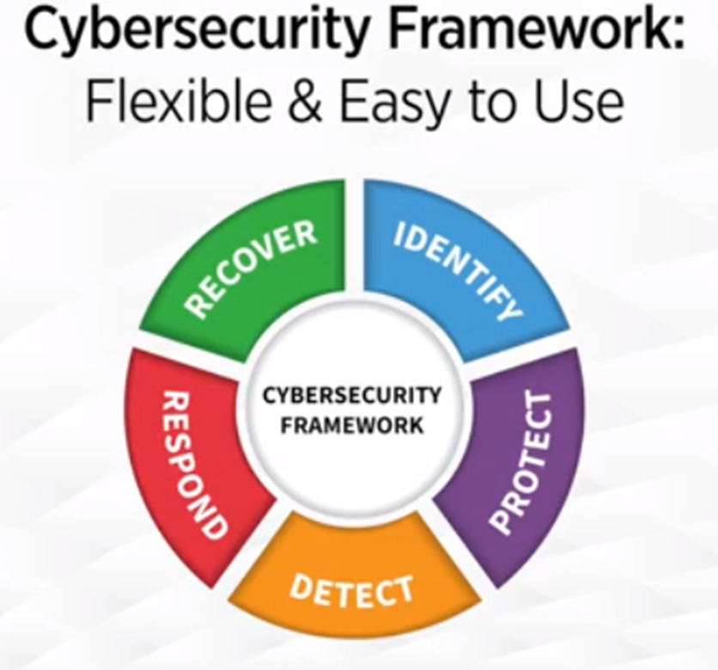
NIST Cybersecurity Framework Goals
Consistent and cost-effective application of security controls
Repeatable processes and assessment results
Technology neutral and flexible
Understanding of enterprise-wide mission risks
Implement an efficient risk-based security and privacy program

Slide 5
NIST Cybersecurity Framework (CSF)
Identify
Protect
Detect
Respond
Recover
Functions
Asset Management
Access Control
Anomalies and Events
Response Planning
Categories
Recovery Planning
Business Environment
Awareness and Training
Security Continuous Monitoring
Communications
Improvements
Governance
Data Security
Analysis
Communications
Detection Processes
Risk Assessment
Info Protection Processes and Procedure
Mitigation
Risk Management Strategy
Improvements
Maintenance
Supply Chain Risk Management
Protective Technology
Notes:
The NIST Cybersecurity Framework is a leading source of directions for cybersecurity programs of any size. By following NIST CSF, small and medium businesses experience fewer breaches and compliance issues for protection against cyberattacks. Created through collaboration between industry and government, the voluntary Framework consists of standards, guidelines, and practices to promote the protection of critical infrastructure.
Source:
https://nvlpubs.nist.gov/nistpubs/CSWP/NIST.CSWP.04162018.pdf
https://www.nist.gov/cyberframework/online-learning/uses-and-benefits-framework

Slide 6

NIST Risk Management Framework (RMF) Steps
Categorize System
Monitor Controls
Select Controls
Prepare
Authorize System
Implement Controls
Assess Controls

Slide 7
NIST RMF Goals
Consistent and cost-effective application of security controls
Repeatable processes and assessment results
Technology neutral and flexible
Understanding of enterprise-wide mission risks
Implement an efficient risk-based security and privacy program
Notes:
The NIST RMF Goals include:
A consistent and cost-effective application of security across your infrastructure. This is how you implement security defenses within your organization.
Repeatable processes provides consistent and comparable assessment results.
A technology neutral and flexible approach means it can fit for any type or size organization
Understanding of enterprise-wide mission risks ties cybersecurity to business processes.
All of this is to implement an efficient, risk-based information security and privacy program.
Understanding cyber risks and taking a risk-based approach to security improves an organization’s effectiveness, efficiency, and depth of protection.

Slide 8
Control Categories & Objectives
People
Technology
Process

